Slide 1


11th Annual COVADIS Summit
（August 29, 2023, Amsterdam, The Netherlands）
Session 3 Networking in Coronary Vasomotor Disorder Research
International CMD Registry
International University of Health and Welfare
Tohoku University
Hiroaki Shimokawa, MD, PhD.

Slide 2
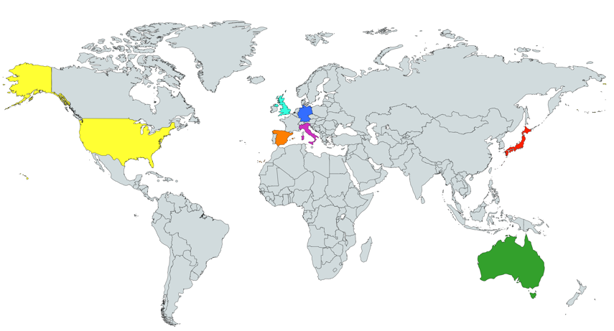
International, Prospective Cohort Study on MVA
by COVADIS
Multi-center study (14 institutes in 7 countries)（July 2015～December 2019）
UK
Prof. Juan Carlos Kaski
(St .George’s University)
Prof. Colin Berry
(University of Glasgow)
Germany
Dr. Peter Ong
Prof. Udo Sechtem
(Robert-Bosch-Krankenhaus)
Spain
Prof. Javier Escaned
(Hospital Clinico San Carlos)
Japan
Prof. Hiroaki Shimokawa
(Tohoku University)
Australia
Prof. John Beltrame
(University of Adelaide)
USA
Prof. C. Noel Bairey Merz
(Cedars-Sinai Medical Center)
Dr. Basmah Safdar
(Yale University)
Italy
Prof. Paolo G. Camici
(Vita-Salute San Raffaele University)
Prof. Filippo Crea
(Catholic University of the Sacred Heart)
(Shimokawa H, et al. Eur Heart J. 2021;42:4592-4600.)

Slide 3







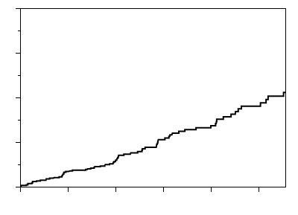
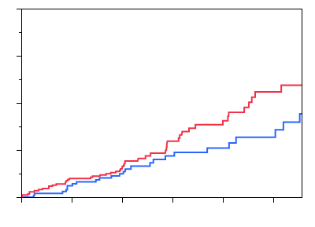
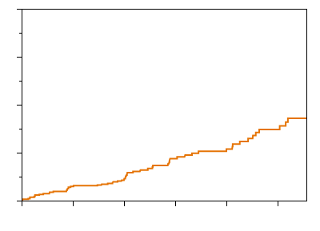
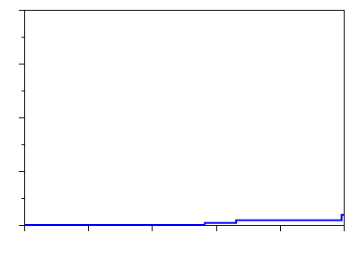
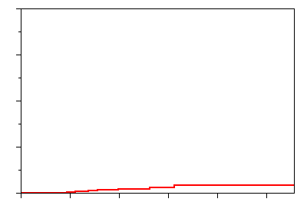
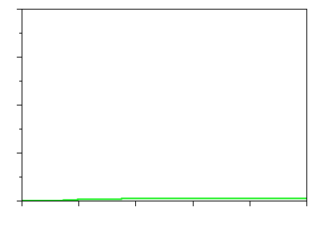
The international cohort study on MVA by COVADIS (N=686)
(N=191)
(N=171)
(N=109)
(N=88)
(N=59)
(N=51)
(N=17)
A
Ethnicity
Sex
Age
Risk factors
Others
<50
(15%)
<80
Dyslipidemia
52%
Hispanic
Male
(36%)
60s
(31%)
Hypertension
52%
Asian
(29%)
Female
(64%)
70s
(23%)
Caucasian
(61%)
Diabetes mellitus
17%
50s
(29%)
Current smoking
16%
D
0
20
40
60
(%)
B
Sex differences in SAQ
C
40
40
Incidence of MACE in the overall cohort
Sex difference in the incidence of MACE
Physical
limitation
Total MACE (N=78)
P<0.0001
30
30
Male (N=248)
Angina
stability
Unstable angina (N=63)
Female (N=438)
P<0.0001
Cardiovascular death (N=9)
Angina
frequency
20
Myocardial infarction (N=5)
20
Cumulative incidence of MACE (%)
Log rank P=0.19
P<0.0001
Acute heart failure (N=1)
Treatment
satisfaction
10
10
P=0.03
Disease
perception
P=0.004
0
0
24
0
20
40
60
80
100
0
6
12
18
24
30
0
6
12
18
30
Follow-up (months)
No. at risk
Follow-up (months)
Male (N=248)
SAQ score
No. at risk
Male
248
238
216
120
90
59
Female (N=438)
678
637
336
227
144
95
Female
430
405
351
133
103
59
(Shimokawa H, et al. Eur Heart J. 2021;42:4592-4600.)

Slide 4
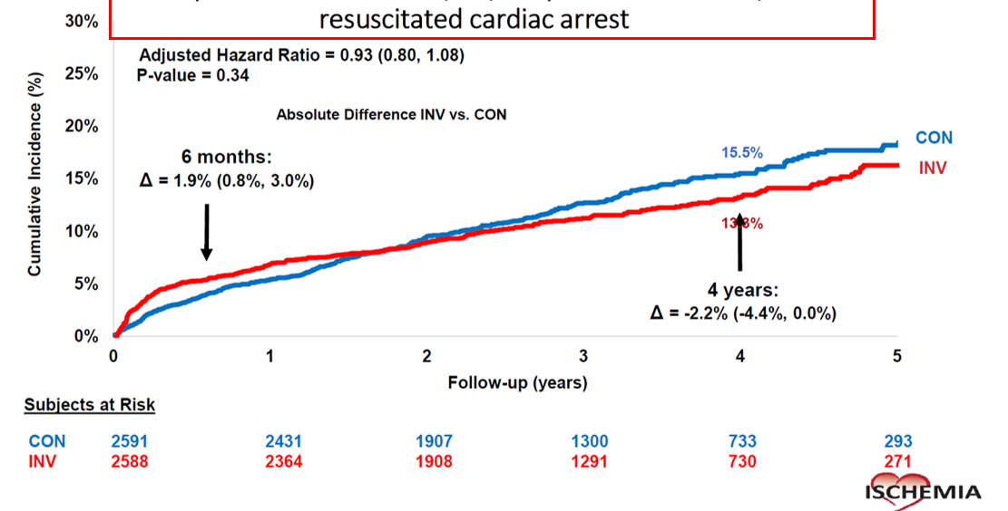
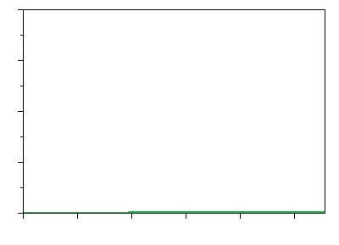
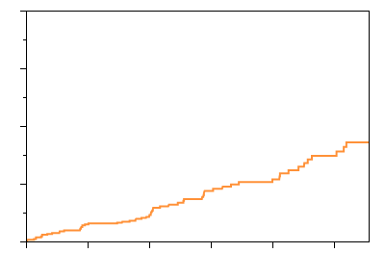
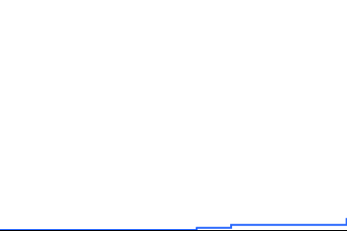
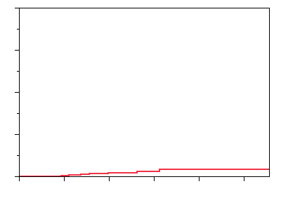
Comparison of Patient Prognosis（MVA vs. IHD）
A
COVADIS Study (MVA)
B
ISCHEMIA Study (IHD)
Major endpoints: CV death, AMI, Admission
(Unstable AP, HF, resuscitated cardiac arrest）
40
Total (N=78)
Unstable AP (N=63)
30
5.0%/yr
CV death (N=9)
7.7%/yr
Cumulative event rate (%)
AMI (N=5)
20
Acute HF (N=1)
10
0
30
0
6
12
18
24
Follow-up (Months)
No. at risk
678
637
336
227
144
95
(Shimokawa H, et al. Eur Heart J. 2021;42:4592-4600.)
(Maron DJ, et al. N Engl J Med. 2020;382:1395-1407.)

Slide 5
Comparison of Patient Prognosis（MVA vs. IHD）
Remaining Questions
Ethnic and sex differences in
1. Clinical characteristics
2. Treatments
3. Long-term prognosis
A
COVADIS Study (MVA)
B
ISCHEMIA Study (IHD)
Major endpoints: CV death, AMI, Admission
(Unstable AP, HF, resuscitated cardiac arrest）
40
Total (N=78)
Unstable AP (N=63)
30
5.0%/yr
CV death (N=9)
7.7%/yr
Cumulative event rate (%)
AMI (N=5)
20
Acute HF (N=1)
10
0
30
0
6
12
18
24
Follow-up (Months)
No. at risk
678
637
336
227
144
95
(Shimokawa H, et al. Eur Heart J. 2021;42:4592-4600.)
(Maron DJ, et al. N Engl J Med. 2020;382:1395-1407.)

Slide 6
Japanese Association of CMD (J-CMD)
(Founded in 2022) （Supported by the Japan Heart Foundation）
北海道
Chairman： Hiroaki Shimokawa（IUHW）
N=28
・ Tohoku Univ
青森
・ Gifu Heart Center
・ Gifu Pref General Med C
秋田
・ IUHW Hosp
・ Teikyo Univ
・ Kawasaki Med Sch
岩手
・ Tsuchiura Kyodo General Hosp.
・ Kurume Univ.
・ Fukuoka Sanno Hosp.
・ NCVC
・ Osaka Univ.
山形
宮城
沖縄
・ Showa Univ.
・ Tokyo Med Univ., Hachioji Med C.
・ National Defense Medical Coll.
・ Ikegami General Hosp.
・ Tokyo Med Dental Univ.
富山
新潟
福島
石川
島根
鳥取
京都
福井
長野
群馬
栃木
山口
広島
岡山
兵庫
滋賀
岐阜
埼玉
茨城
・ Kumamoto Univ.
佐賀
福岡
大阪
山梨
東京
愛媛
香川
愛知
神奈川
千葉
長崎
大分
徳島
奈良
三重
静岡
・ Chiba Univ.
・ New Tokyo Hosp.
・ IUHW Hosp. (Narita)
・ Miyazaki Univ.
高知
熊本
・ Ehime Univ.
和歌山
・ Mie Univ.
宮崎
鹿児島
・ Wakayama Med Univ.
・ Fujita Med Univ.
・ Aichi Med Univ.
・ Showa Univ. Fujigaoka Hosp.

Slide 7
Issues to be discussed
1. Running cost (Sponsors)
2. IRB approval
3. Registration job at each institute
4. Data management
5. Data analysis

